Slide 1

Family Farmer: Smart Irrigation & Community Farming
Presented by: Mahendra, Nagaraju, Jaswanth, Tarun
Domain: AgriTech
Platform: Mobile Application
Objective: Enhance yield, optimize water, connect farmers with families.

Slide 2
Challenges Faced by Farmers Today
Inefficient Water Use
Suboptimal Crop Choices
Limited Weather Insights
Middleman Dependency
Lack of irrigation planning leads to significant wastage.
Farmers often select crops without soil or season data.
Restricted access to real-time weather information.
Reliance on intermediaries reduces farmer profits.
Lack of Support
Small farmers lack financial and community backing.
Resulting in low yields, wasted resources, and reduced farmer income.

Slide 3
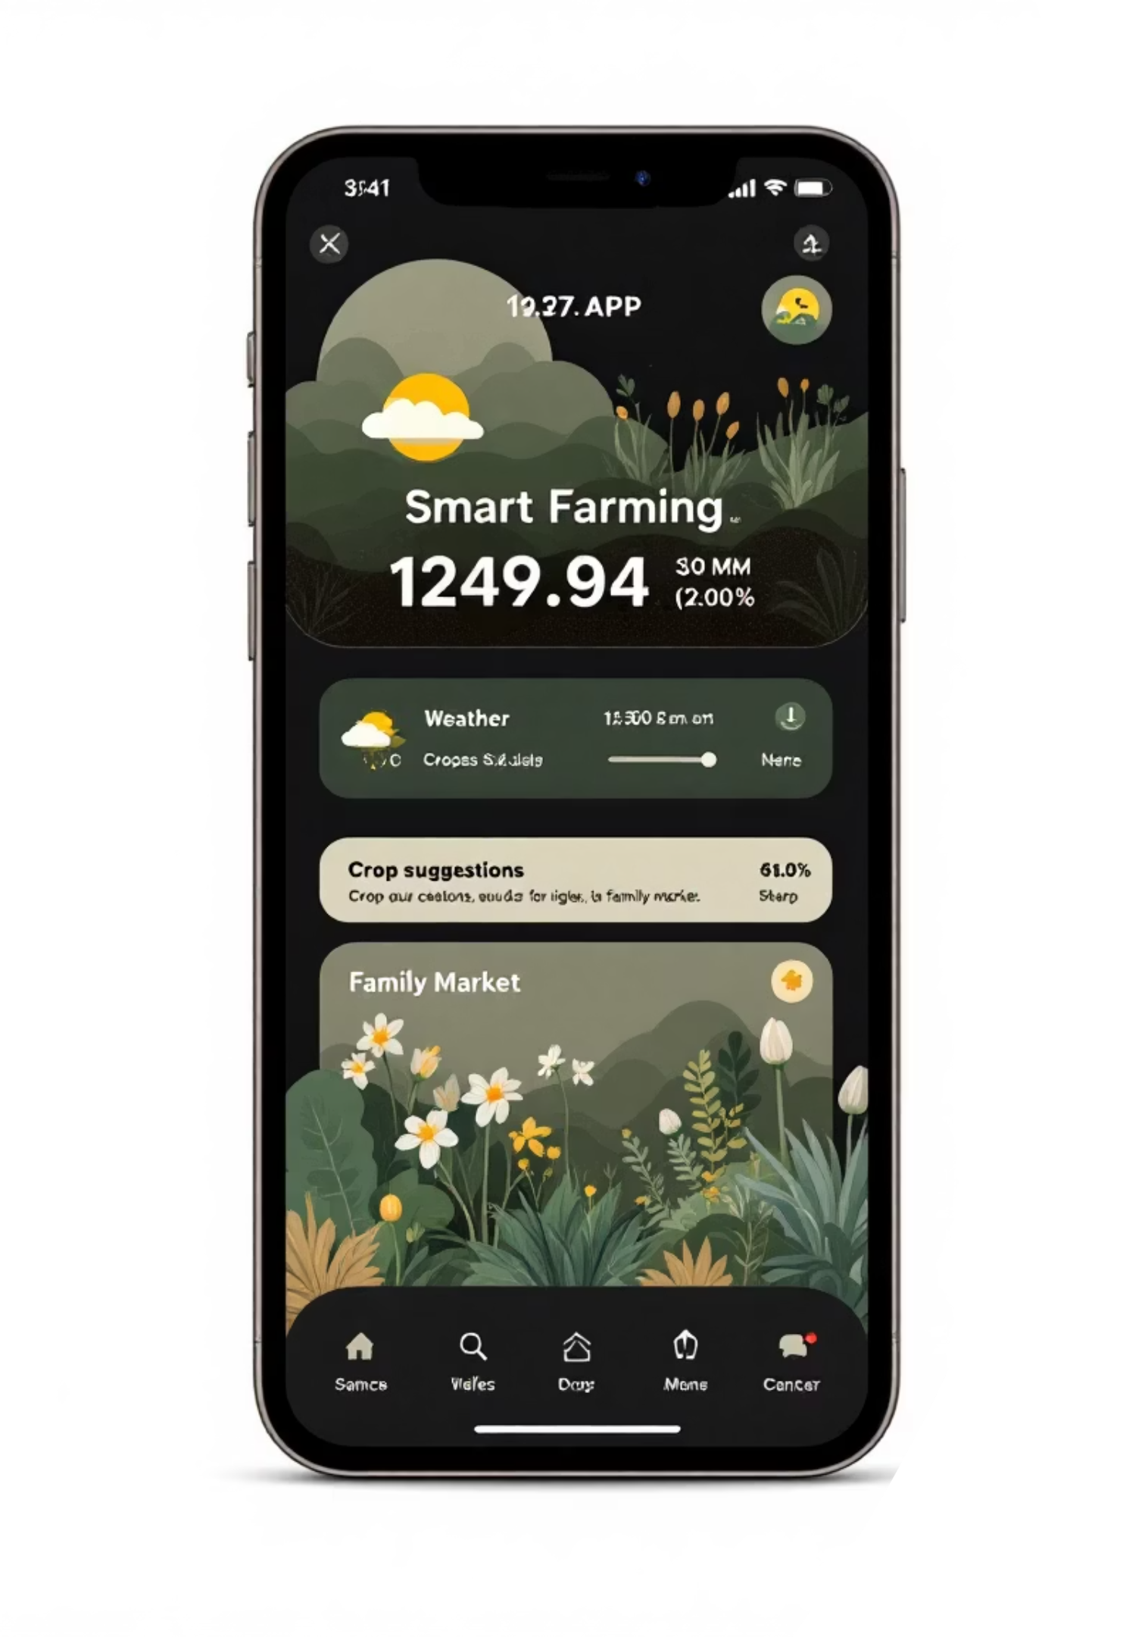
Introducing the Family Farmer App
A Mobile-Based Smart Farming & Support System
Weather-based irrigation guidance for optimal water use.
Crop recommendations tailored to soil and season.
Direct connection between farmers and supportive families.
Seamless farm-to-family produce selling.
Outcome: Sustainable farming, higher yields, and fair farmer income.

Slide 4
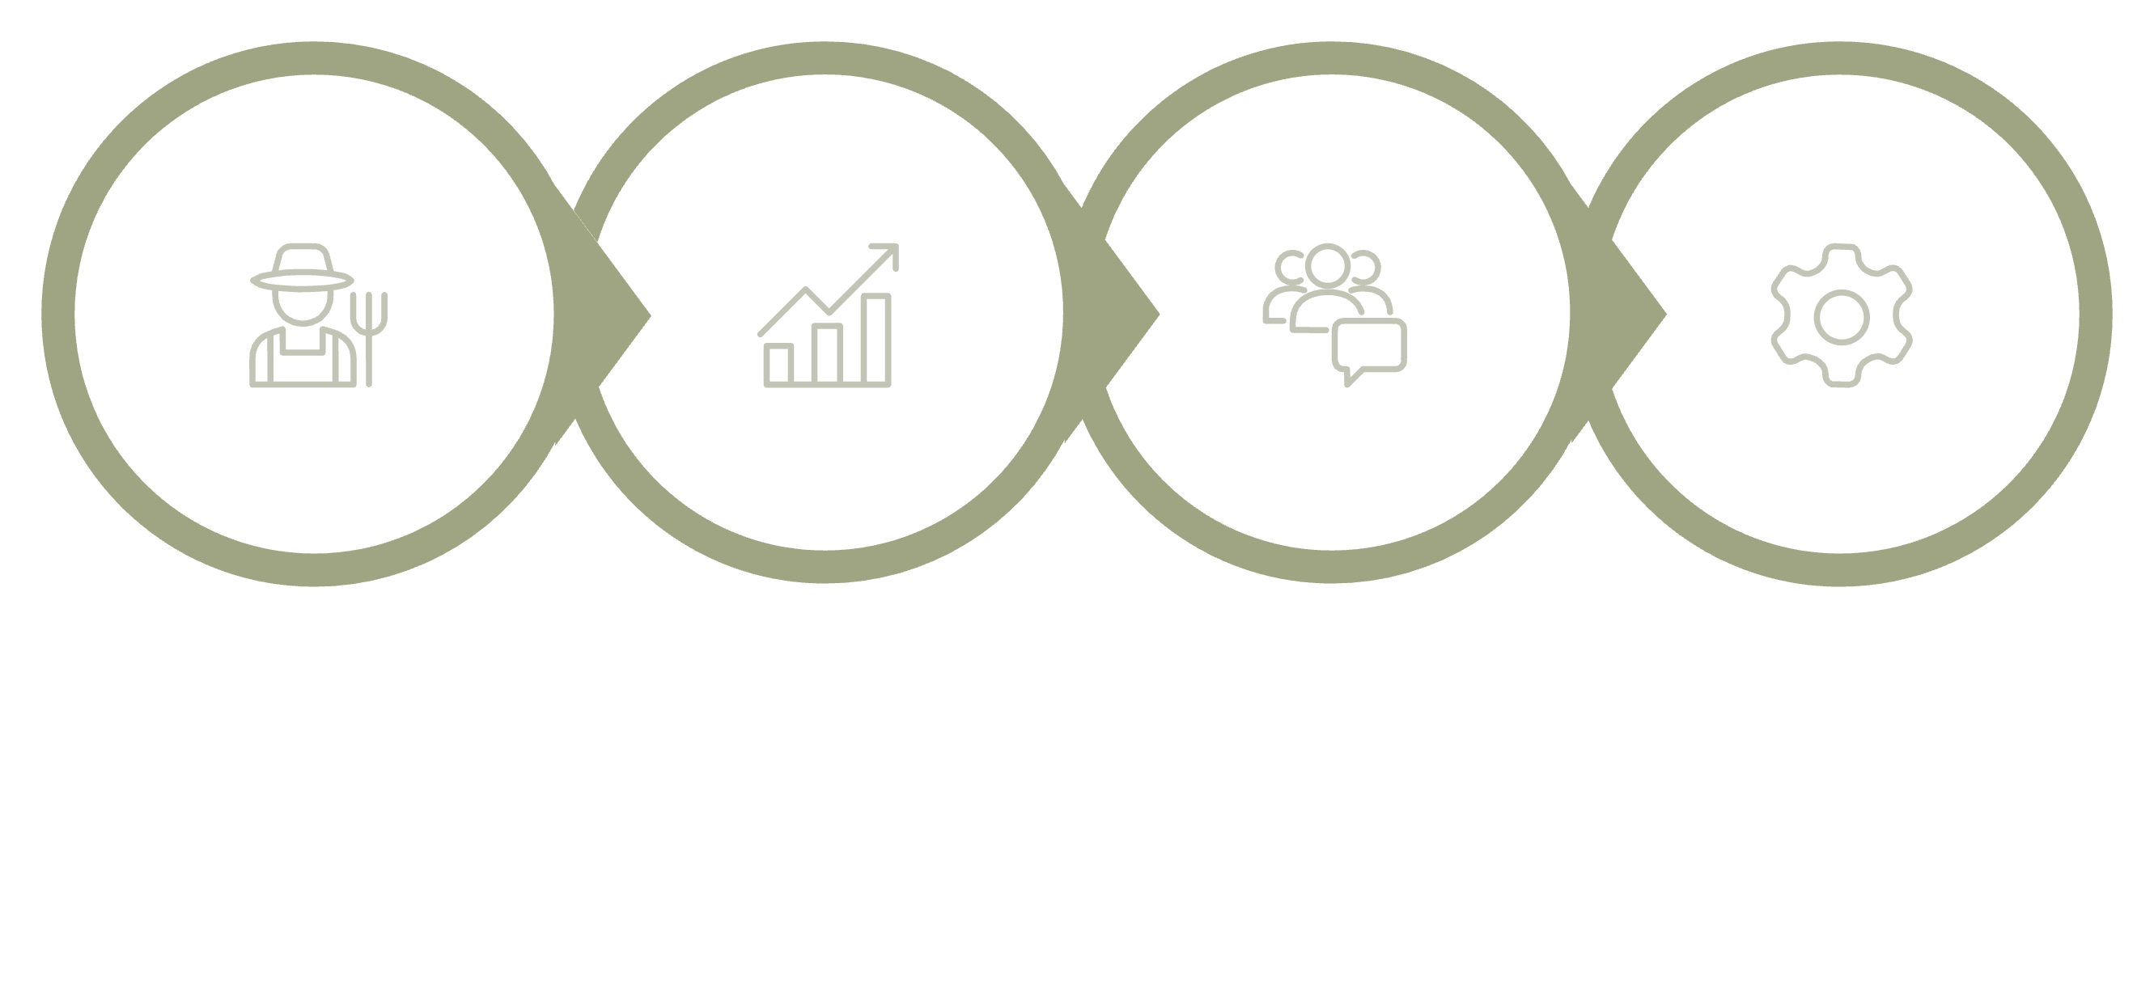

How the System Works
Farmer Registers
App Processes
Families Connect
Admin Guides
Our system streamlines the farming process, connecting all stakeholders for mutual benefit.

Slide 5
Core Features
Farmer & Family Registration
Real-time Weather Updates
Secure onboarding and profile management.
Accurate, location-specific forecasts.
Soil Monitoring (Manual Input)
Smart Irrigation Alerts
Track soil type and moisture for informed decisions.
Timely notifications for optimal watering schedules.
Crop Recommendation Engine
Family Support & Marketplace
Suggests best crops based on data analysis.
Connects farmers to consumers for direct sales and community help.

Slide 6
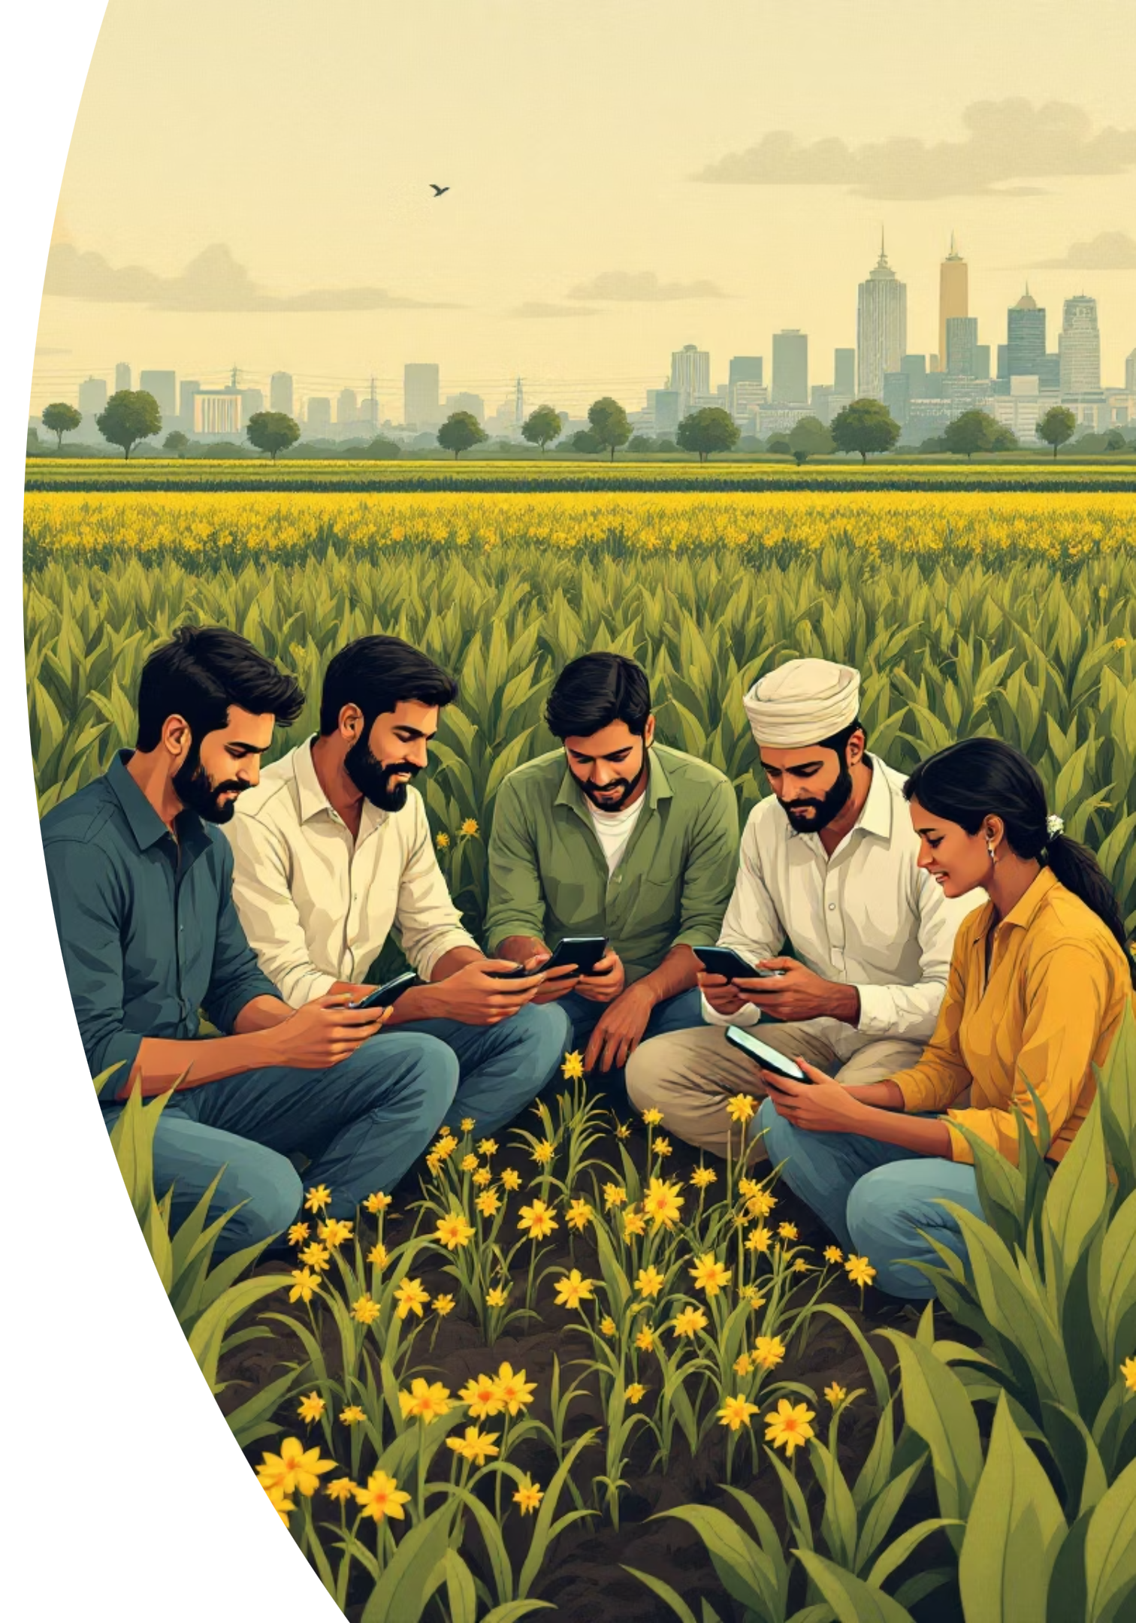

Market Scope & Impact
Vast Agricultural Workforce: India's large farming population.
Smartphone Adoption: Growing digital literacy among farmers.
Water Efficiency Demand: High need for smart irrigation.
Direct-to-Consumer Trend: Rising interest in farm-fresh produce.
Partnership Potential: Strong collaborations with government, NGOs, and AgriTech.
Future Expansion:
IoT integration for automation and AI-based yield prediction.

Slide 7

Tools & Technologies Utilised
Technology Stack
Frontend Mobile App: Lovable (AI-based development tool)
Backend: Firebase / Supabase (Scalable cloud solutions)
Authentication & Database: Integrated within backend platforms
APIs: OpenWeather for accurate weather data
Logic: Rule-based system for precise crop and irrigation recommendations

Slide 8
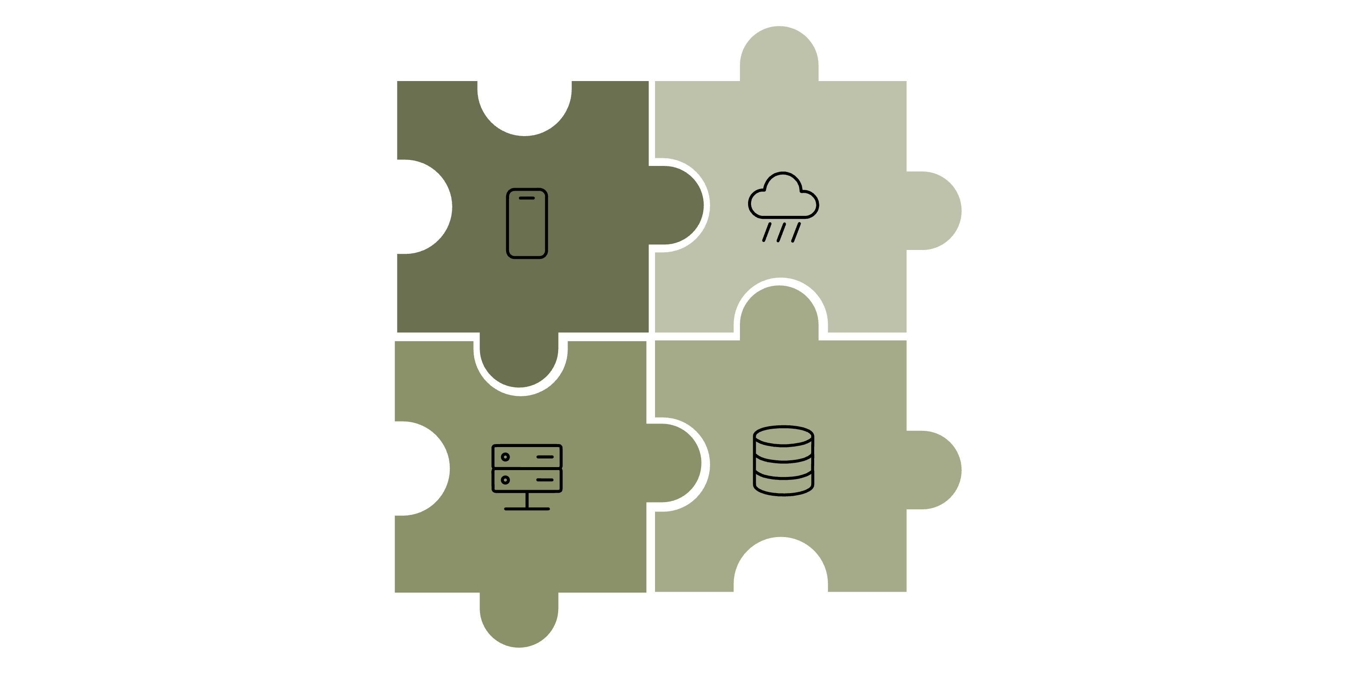
System Architecture
Mobile App
Weather API
Backend Server
Database
Our design focuses on scalability, cost-effectiveness, and user-friendliness for farmers.

Slide 9
Implementation Milestones
01
02
Requirement Analysis & Planning
UI/UX Design (Lovable)
Define features and scope.
Create intuitive user interfaces.
03
04
Authentication Implementation
Data Integration
Secure role-based access.
Weather and soil data feeds.
05
06
Logic Development
Marketplace & Support Modules
Crop and irrigation algorithms.
Farmer-family connection features.
07
08
Testing & Validation
Deployment & Demo
Ensure robust functionality.
Launch and showcase the platform.

Slide 10

Conclusion & Future Vision
Family Farmer: Empowering Agriculture
Smart & Sustainable: Improved yield, reduced water wastage.
Community Connected: Stronger bonds between farmers and families.
Supported Agriculture: Fostering a thriving ecosystem.
Future Enhancements:
IoT soil moisture sensors for automated data.
AI-based crop yield prediction for advanced insights.
Voice support in local languages for accessibility.
Offline access for seamless rural use.

